Slide 1
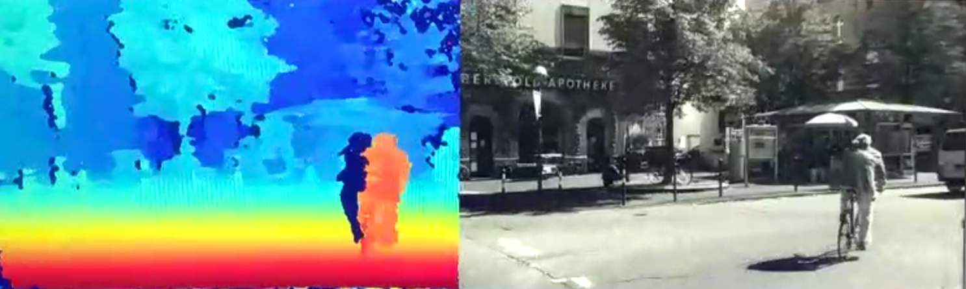
3Deepercept
stereo vision 3D sensor
percept the world deeper with stereo vision 3D sensor

Slide 2

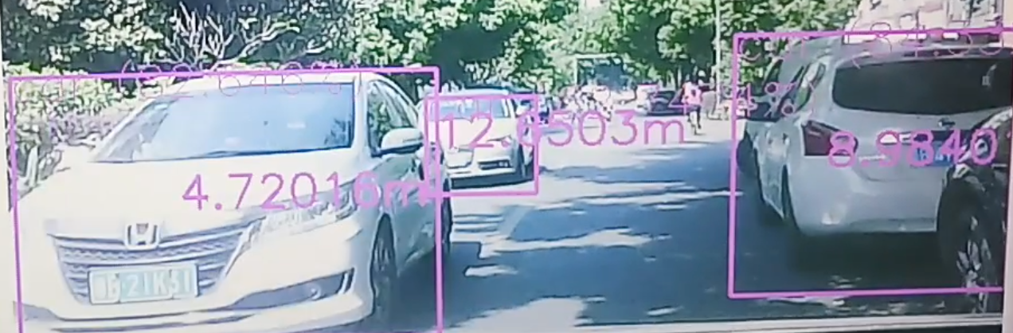
Why we develop 3D sensor
percept the world deeper with stereo vision 3D sensor
Applications like 3D reconstruction,flying drone,ADAS,robots,vslam,etc. requires dense 3D (x,y,z) point cloud.
traditional single camera solution is very difficult in doing this .
3D sensor is becoming a basic module in various intelligent systems,it is just like our human eyes, knowing the precise or rough distance of a object is crucial !
Detection with no distance
Detection with distance

Slide 3
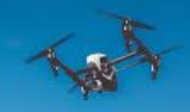
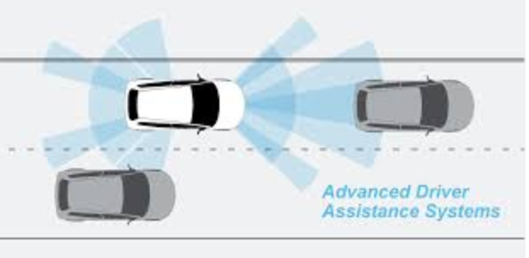

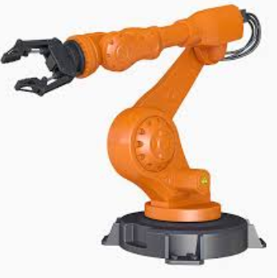
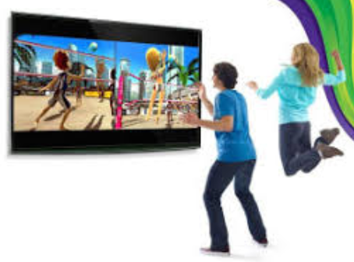
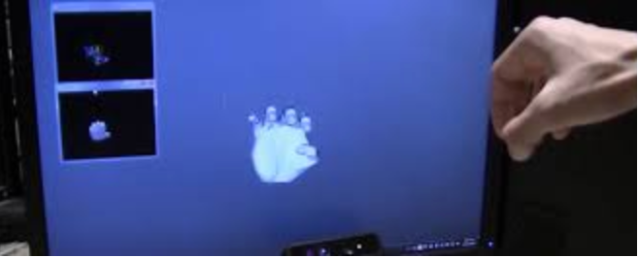
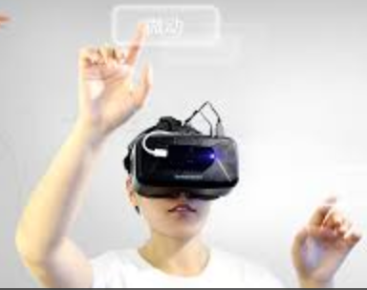
Applications & market
percept the world deeper with stereo vision 3D sensor
flying drone, obstacle avoidance,human following,hand gesture recognition and control, etc…
ADAS, pedestrian detection, car detection …
robot,navigation and collision avoidance, hunan following, etc…
industrial robot-arm. locate the objects by vision.
human-machine interaction. for instance, Kinect alike game,hand pose controlled GUI,etc..
many many other applications where depth or 3D point cloud are required.
the market is huge,due to the fact that more and more intelligent system needs depth info and dense point cloud.
drone
ADAS
robot-arm
hand pose tracking
hand controlled
VR menu
robot
body-pose-sensing
game

Slide 4
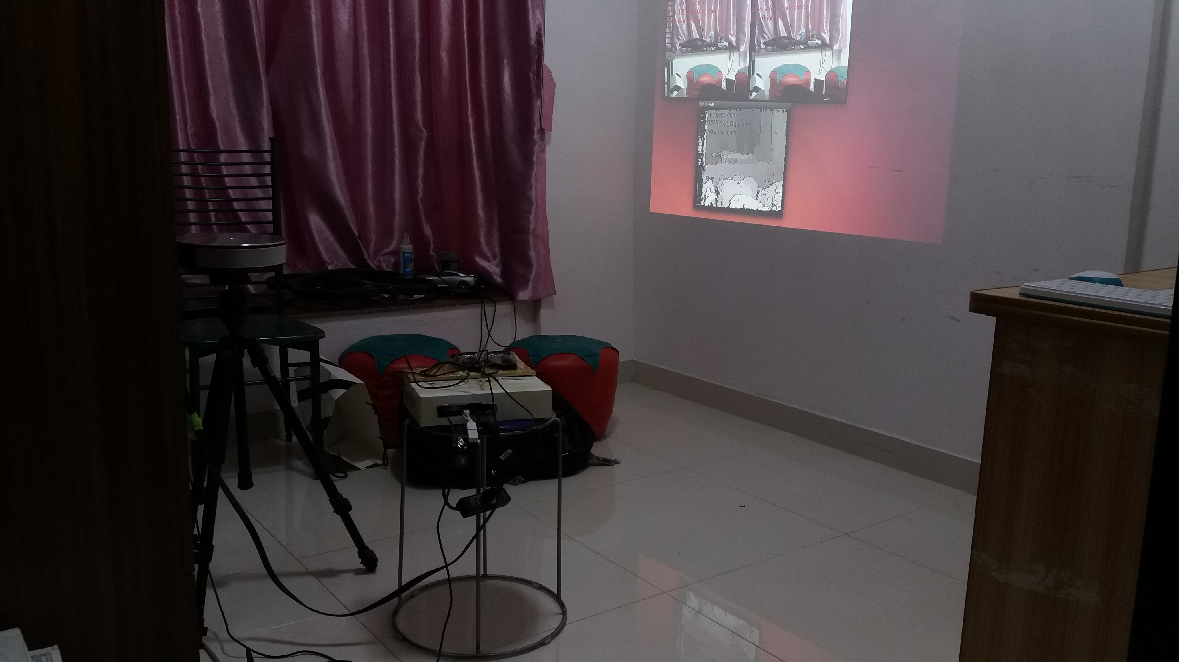
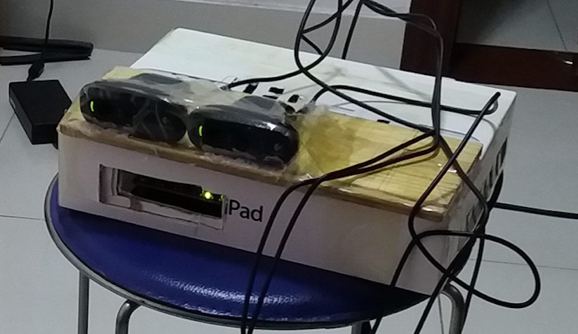
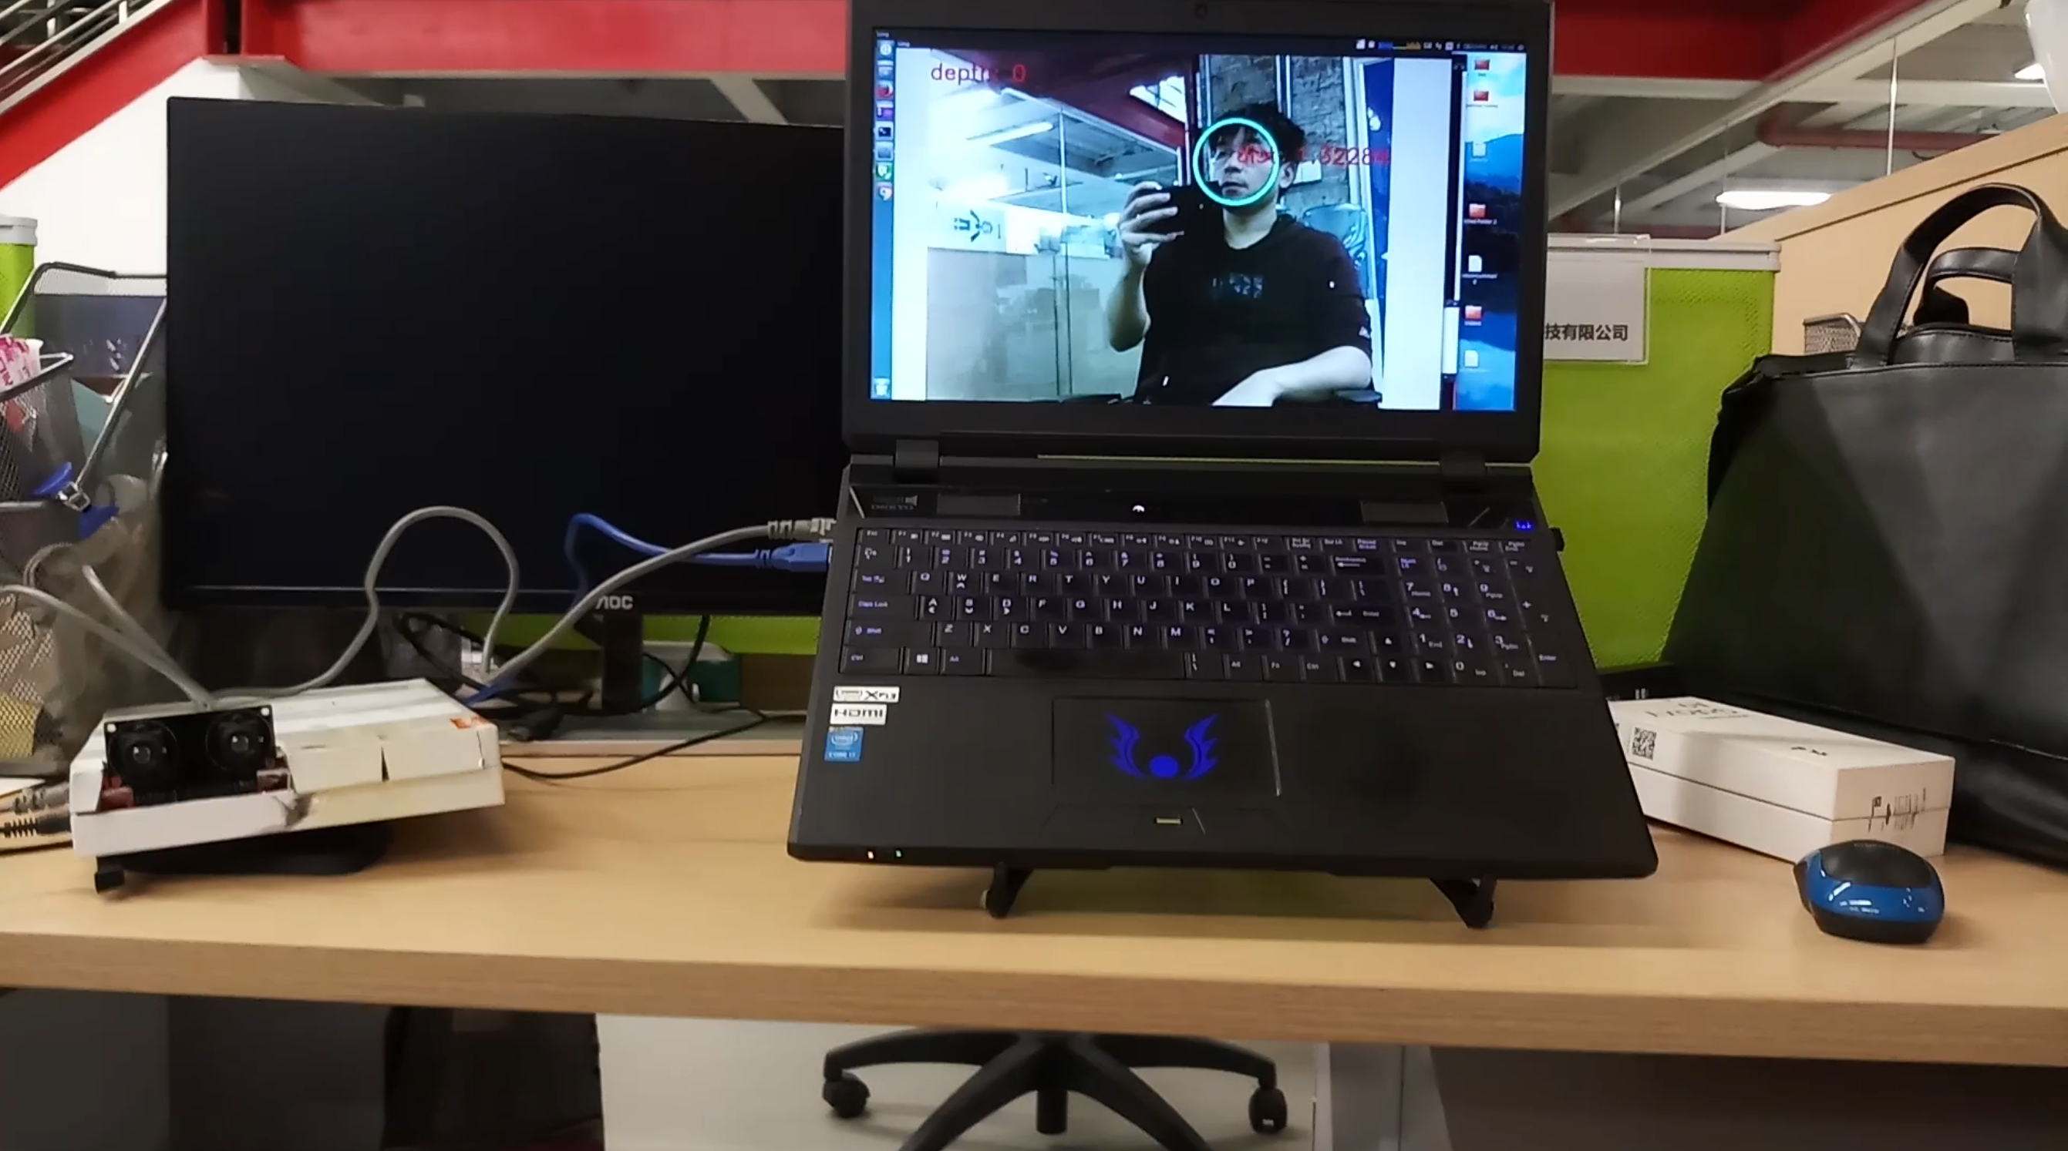

Prototype evolution,still improving
percept the world deeper with stereo vision 3D sensor
Version 1.0 on GPU
version 2.0 on FPGA，higher frame rate

Slide 5
Types of 3D sensor, pros & cons
percept the world deeper with stereo vision 3D sensor
 | stereo vision 3D sensor | structure light 3D sensor | TOF(time of flight) 3D sensor
in door | yes (structure light stereo vision 3D sensor) | yes | yes
out door under sun light | yes | no | yes
resolution at same frame rate | High（up to 1080p) | low (640 x 480) | lower
fame rate | High (60+ FPS) | low | lower
calibration between depth and colour images | No | yes | yes
cost | low | high | higher
algorithm complexity | higher | high | low
manufacture complexity | low | high | high
from the above comparison we can see that stereo vision 3D sensor is low-cost and has much wider application field, ranging from in-door to out-door, from low-end to high-end applications.

Slide 6
Stereo vision problems
percept the world deeper with stereo vision 3D sensor
very heavy computational intensity
impossible for embedded ARM processor to meet the realtime requirement.

Slide 7
Solutions for stereo vision, pros & cons
percept the world deeper with stereo vision 3D sensor
hardware solutions to realtime stereo vision problems are : GPU,FPGA and ASIC
 | GPU | FPGA | ASIC
Power consumption | High | low | lower
design complexity | easy | hard | harder
fame rate | low | high | high
cost | high | low | very high investment and risk
time to market | faster | fast | slow
In all,FPGA solution is suitable for start-up company to open the market and ASIC validation.

Slide 8
Our solution
percept the world deeper with stereo vision 3D sensor
our hardware solution is FPGA
we have tried both GPU and FPGA solutions
FPGA wins in both performance and power consumption in this case, and it is suitable for startups company before converting it into ASIC

Slide 9





Competitors
percept the world deeper with stereo vision 3D sensor
stereo vision
TOF
structure light
structure light
structure light
……

Slide 10
Business model and potential volume
percept the world deeper with stereo vision 3D sensor
selling FPGA IP,no hardware design is needed
design our own hardware, and provide customers with 3D sensor module
providing customers with whole application solutions based on 3D sensor
the sales volume is huge, for instance in drone related market,each drone would require several 3D sensors. in robot-arm && laser marking machine application, with 3D sensor helping locating the 3D location of the target object,it has strong requirement to improve the productivity.

Slide 11
Roadmap in 1 year
percept the world deeper with stereo vision 3D sensor
Looking for partners to sell FPGA IP, ongoing .
For converting prototype to mass production, 3-6 month.
For developing Deep learning object detection module, need approximately 6 months.
to be developed
3D world
3D sensor
Deep learning
AI
3D observation
3D perception

Slide 12

Team
percept the world deeper with stereo vision 3D sensor
wuchenghe(Brian)
10+ years of algorithm design and large scale FPGA design experience,very rich work experience and knowledge in computer vision,machine learning and deep learning. skilled at embedded ARM linux os,device driver,and embedded app. skilled at CUDA programming,
OpenGL,and android JNI.
For more please visit my linkedin
webpage.
Xu Lin
skilled at website promotion and SEO
http://www.linkedin.com/in/brianwchh/

Slide 13
prototype video demos
percept the world deeper with stereo vision 3D sensor
3D sensor for human pose recognition,for applications like kinect
game,menu remote control with bare hand gestures
https://youtu.be/vFztyy0xzRw
precision test. visual ruler,measure without a physical ruler
https://youtu.be/iO0MZLmZf58
realtime stereo vision demo,the depth image demo
https://youtu.be/se1tIy5UWpE

Slide 14
Contact us
percept the world deeper with stereo vision 3D sensor
brianwchh@gmail.com
cell: +65 92356303
www.3Deepercept.com
AngelList-company profile

